Slide 1

How CSS works
By Amit Tyagi
amittyagi.mymail@gmail.com

Slide 2

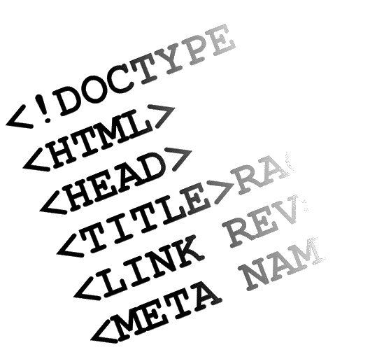

What is CSS
Cascading Style Sheets
Contains the rules for the presentation of HTML.
+ =
HTML CSS Web Page
CSS was introduced to keep the presentation information separate from HTML markup (content).

Slide 3
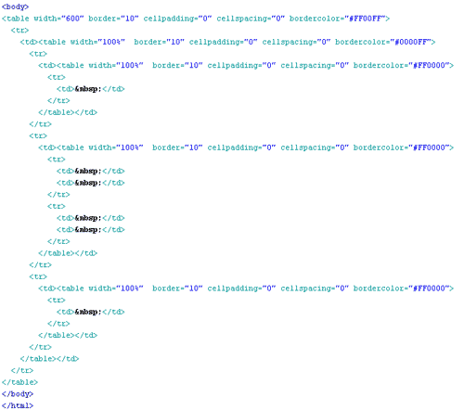
Before CSS
Initially Designers used presentation tags like (FONT, B, BR, TABLE etc.) and spacers GIFs to control the design of web pages.

Slide 4

Any modification in the design of websites was a very difficult and boring task , as it evolves manually editing every HTML page.

Slide 5
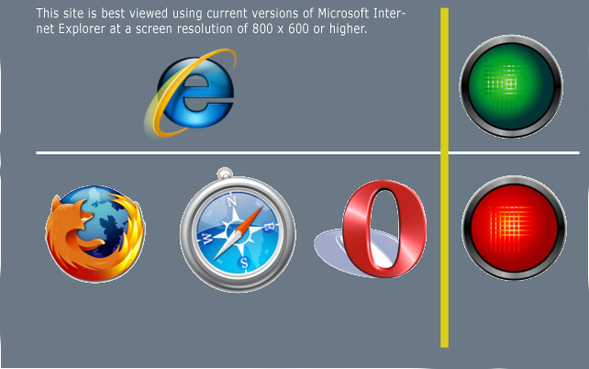
Providing support for multiple browsers was a difficult task.

Slide 6
CSS – brief history
Style sheets have existed in one form or another since the beginnings of SGML in the 1970s.
In 1996, CSS level 1 Recommendation was published in December.
CSS level2 was published as a W3C Recommendation on May 12, 1998
CSS level3 is still under development.

Slide 7
Sources of Styles
Author (developer) Styles
Inline Styles - As inline attribute “style” inside HTML tags
<div style=“font-weight: bold;”>I am bold</div>
Embedded Styles - As embedded style tag with in HTML document.
  <html>
  <head>
      <title>Welcome to Vendio!</title>
      <style>
      .footer {
      width:90%;
      }
      </style>
      -------
  </html>
Linked Styles - Inside separate files with .css extension
<link rel="stylesheet" href=“external.css" type="text/css" />

Slide 8
Sources of Styles(contd.)
User Style sheets
This file contains the user created styles .
[firefox profile folder]/ chrome/userContent-example.css is the current user’s style sheet file for the firefox.
Browser default style sheet
This file contains default styles for all users of a browser
[firefox folder]/res/html.css is the default style sheet file for the firefox.

Slide 9

Cascade
The CSS cascade assigns a weight to each style rule. When several rules apply, the one with the greatest weight takes precedence.
Order of preference for various styles:
  Default browser style sheet (weakest)
  User style sheet
  Author style sheet
  Author embedded styles
  Author inline styles (strongest)

Slide 10
CSS Selectors
ID based ( #)
HTML CSS
<div id=“content”> #content {
Text width: 200px;
</div> }
ID selectors should be used with single elements.

Slide 11
Class based selector
Class (.)
HTML CSS
<div class=“big”> .content {
Text width: 200px;
</div> }
<div>
<span class=“big”>some text </span>
</div>
Class based styles can be used by multiple HTML elements.

Slide 12
Tag based selectors
Tag (Tag name)
HTML CSS
<div> DIV {
Text width: 200px;
</div> }
<div> SPAN {
<span>some text </span> font-size:130%;
</div> }
<span>some other text </span>

Slide 13
Grouping
Multiple selectors can be grouped in a single style declaration by using , .
  H1, P , .main {
  font-weight:bold;
  }

Slide 14
Descendant selectors
Descendant selectors are used to select elements that are descendants (not necessarily children) of another element in the document tree.
HTML CSS
<div class=“abc”> DIV.abc P {
<div> font-weight:bold;
<P> }
Hello there! </p>
</div>
</div>

Slide 15
Child selectors
A child selector is used to select an element that is a direct child of another element (parent). Child selectors will not select all descendants, only direct children.
HTML CSS
<div > DIV.abc > P {
<div class=“abc”> font-weight:bold;
<P> }
Hello there! </p>
</div>
</div>

Slide 16
Universal selectors
Universal selectors are used to select any element.
* {
color: blue;
}

Slide 17
Adjacent sibling selectors
Adjacent sibling selectors will select the sibling immediately following an element.
  DIV.abc + P {
  font-weight: bold;
  }
  will work for
  <div>
  <div class=“abc”>Message</div>
  <P>Hello there!</p>
  </div>

Slide 18
Attribute selectors
Attribute selectors selects elements based upon the attributes present in the HTML Tags and their value.
  IMG[src="small.gif"] {
  border: 1px solid #000;
  }
  will work for
  <img src=“small.gif” />

Slide 19
CSS Pseudo-classes
selector:pseudo-class { property: value }
:link
:visited } Link (A tag) related pseudo classes
:hover
:active
:after
:before
:first-child
:focus
:first-letter
:first-line
:lang

Slide 20
CSS Values
Words: text-align:center;.
Numerical values: Numerical values are usually followed by a unit type.
font-size:12px;
12 is the numerical value and px is the unit type pixels.
  Absolute Values – in, pc, px, cm, mm, pt
  Relative Values – em, ex, %
Color values: color:#336699 or color#369.

Slide 21
Categories of CSS properties
Positioning and layout handling related.
Background related properties.
Font and text related
Links related.
Lists related.
Table related.

Slide 22
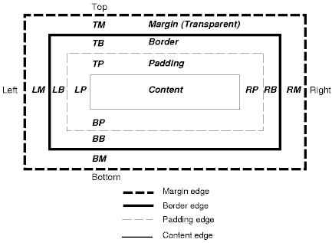
Box model

Slide 23
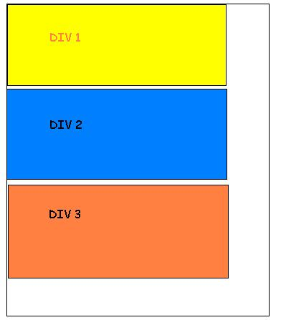
The Display Property
Block Level elements, such as DIVs, paragraphs, headings, and lists, sit one above another when displayed in the browser.
HTML
<body>
<div id=“div1”></div>
<div id=“div2”></div>
<div id=“div3”></div>
</body>
CSS
#div1 { width:300px;background:yellow;}
#div1 { width:300px;background:blue;}
#div1 { width:300px;background:orange;}

Slide 24

Inline Elements
Inline elements such as a, span, and img, sit side by side when they are displayed in the browser and only appear on a new line if there is insufficient room on the previous one.
<div id="row1" >
<span class="norm">This is small text and </span>
<span class="big">this is big</span>
<span class="italicText"> I am Italic</span>
</div>
.norm {
color:red;
}
.big {
color:blue;
font-weight:bold;
}
.italicText {
color:green;
font-style:italic;
}
#row1 {
padding:10px;
border:solid 1px #000;
}

Slide 25
Display property
none inline
block list-item
run-in compact
marker table
inline-table inline-block
table-row-group table-header-group
table-footer-group table-row
table-column-group table-column
table-cell table-caption

Slide 26

Visibility
Visible : The element is visible (default).
Hidden : The element is invisible (but still takes up space)
.big {
visibility:hidden;
}

Slide 27
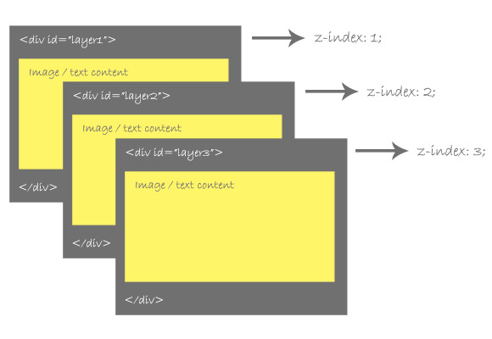
z-index
The z-index property specifies the stack order of an element.
An element with greater stack order is always in front of an element with a lower stack order.
only works on positioned elements (position:absolute, position:relative, or position:fixed).

Slide 28
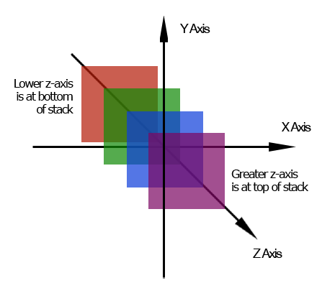
Default page flow
Always think of web page as 3D arrangement of different layers.

Slide 29
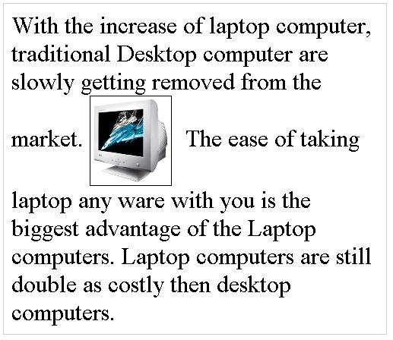
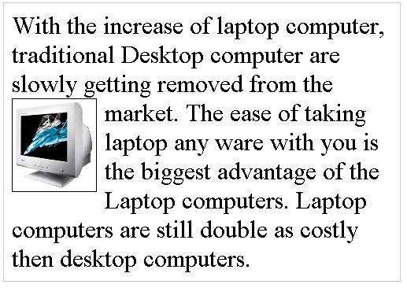
Floating
float:left, right, none;
A floated box is laid out according to the normal flow, then taken out of the flow and shifted to the left or right as far as possible.
IMG { float:left;
}

Slide 30
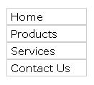
Floating multiple elements
Floated boxes will move to the left or right until their outer edge touches the containing block edge or the outer edge of another float.
<ul>
<li>Home</li>
<li>Products</li>
<li>Services</li>
<li>Contact Us</li>
</ul>
After applying
LI {
float:left;
}

Slide 31
Clearing Floats
Clear:both ;
Or
<style type="text/css">
.clearfix:after {
content: "."; display: block; height: 0; clear: both; visibility: hidden; } .clearfix {display: inline-block;} /* for IE/Mac */
</style>
<!--[if IE]><style type="text/css">
.clearfix { zoom: 1; display: block; }
</style> <![endif]-->

Slide 32
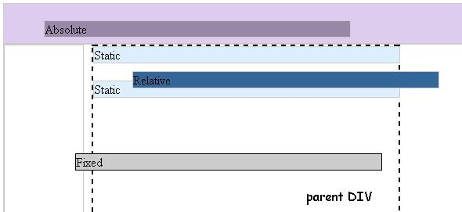
Positioning - static
position:static; (Default option) the element occurs in the normal flow (ignores any top, bottom, left, right, or z-index declarations)

Slide 33
Positioning - relative
position:relative; Generates a relatively positioned element, positioned relative to its normal position, use bottom, right, top and left property to place element. Default flow of other elements don’t change.

Slide 34
Positioning - absolute
position:relative; Generates an absolutely positioned element, positioned relative to the first parent element that has a position other than static (if none is found, relative to document’s BODY). use bottom, right, top and left property to place element

Slide 35
Positioning - fixed
position:relative; Generates an absolutely positioned element, positioned relative to the browser window and don’t change even after page scroll. use bottom, right, top and left property to place element

Slide 36
Inheritance
Styles that relate to text and appearance are inherited by the descendant elements.
Styles that relate to the appearance of boxes created by styling DIVs, paragraphs, and other elements, such as borders, padding, margins are not inherited.

Slide 37


Slide 38
Refrences
www.w3schools.com
www.w3.org
World wide web

